Slide 1
PV Converter Board
Receiver Unit Testing Results,
Updated Design Calculations and Schematics

Slide 2
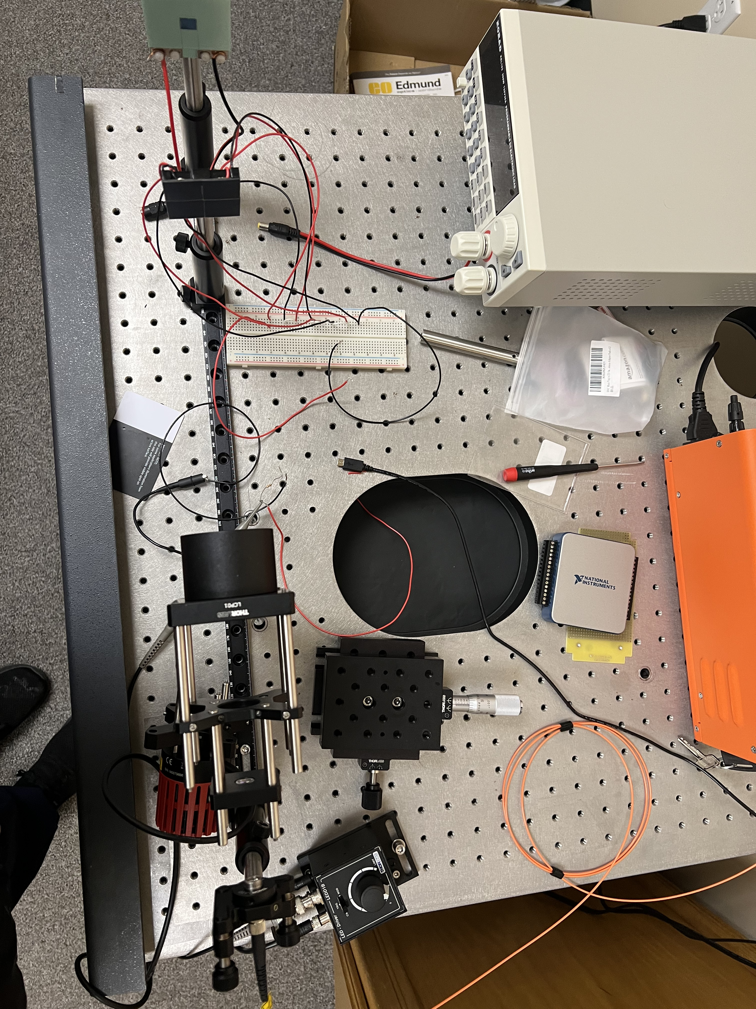
Receiver Unit Testing

Slide 3
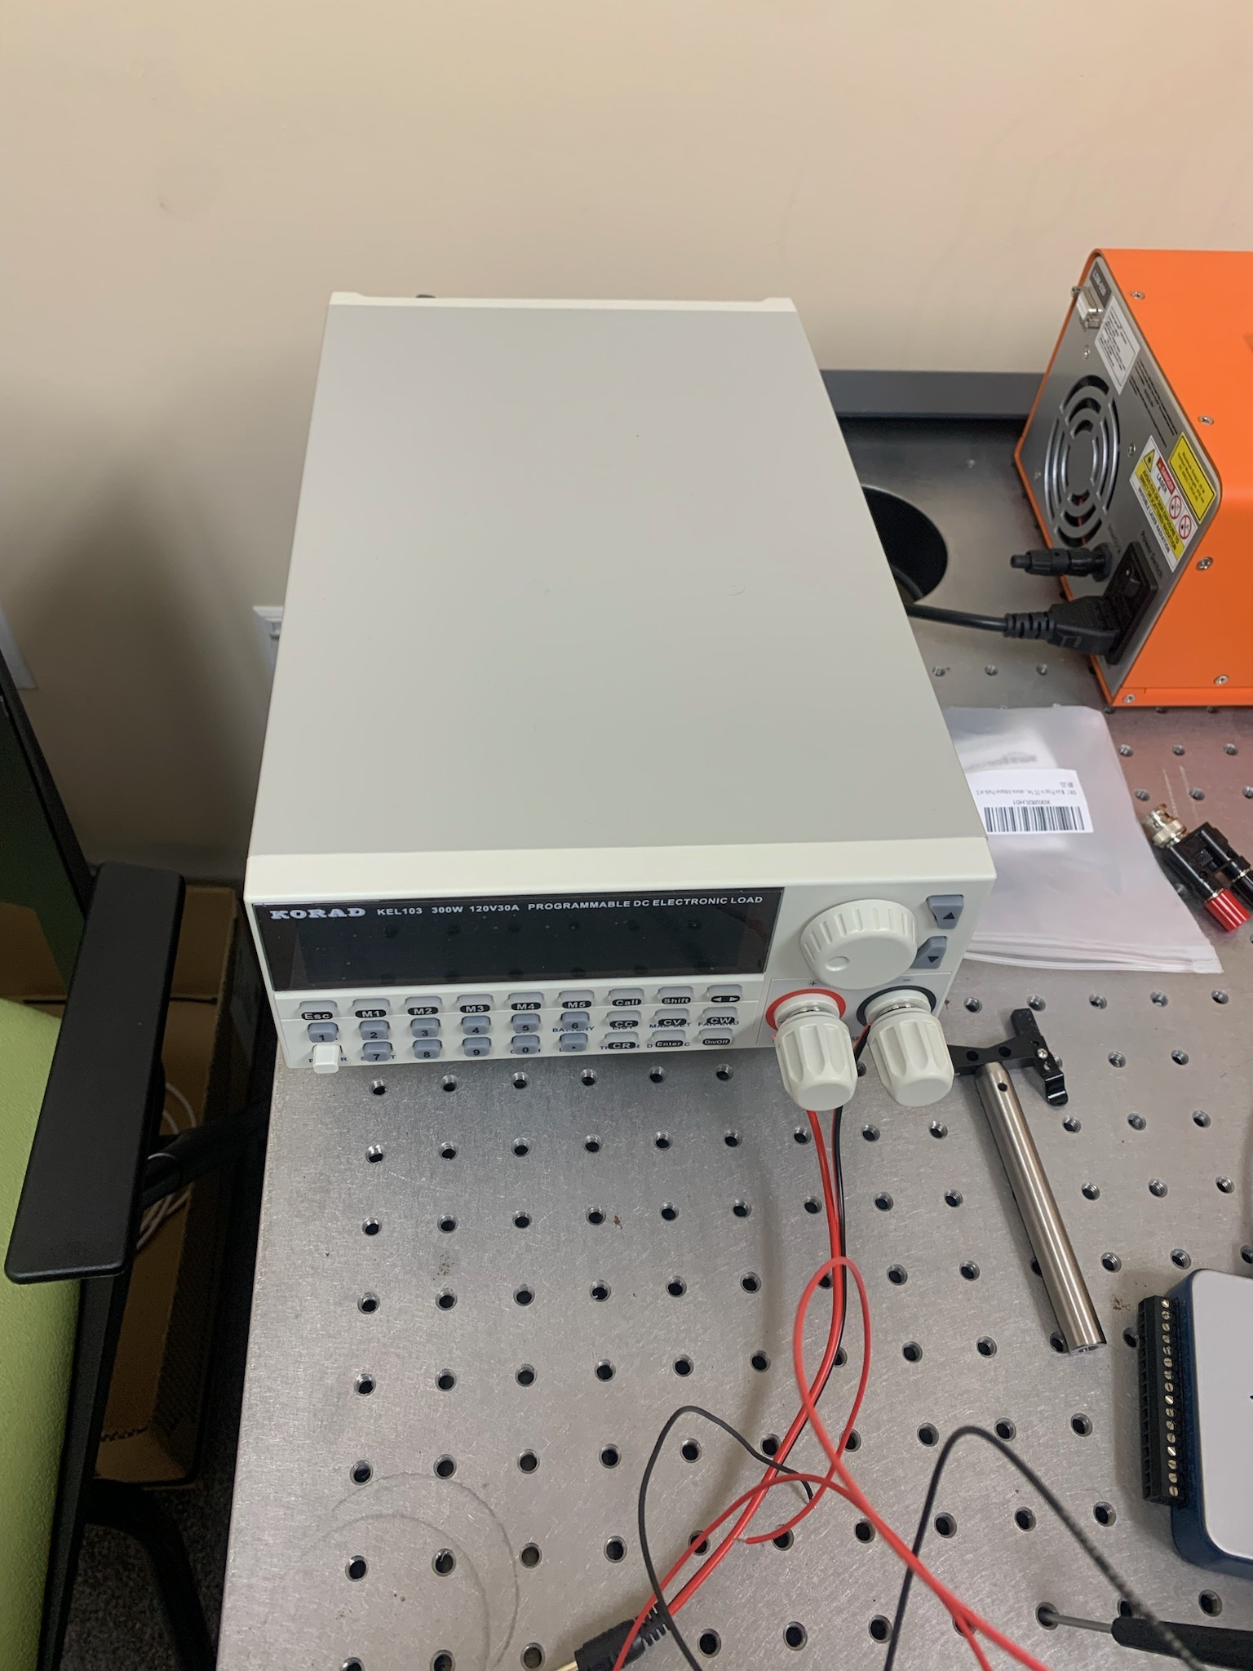
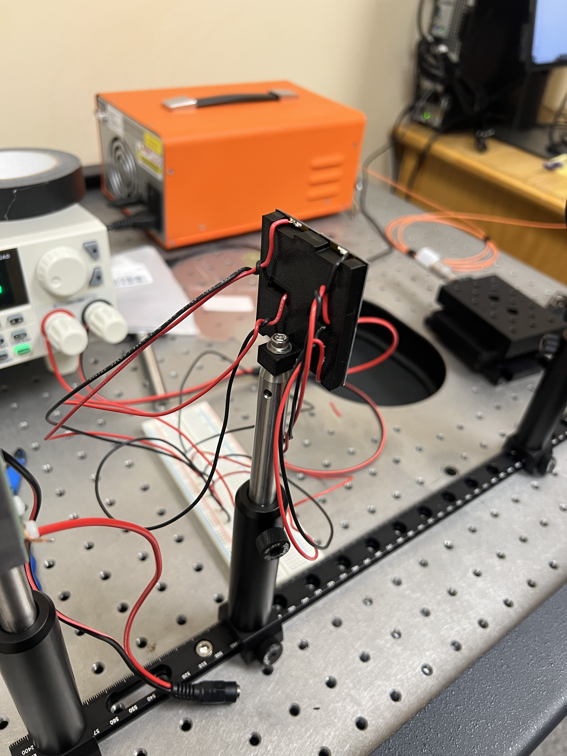

Slide 4
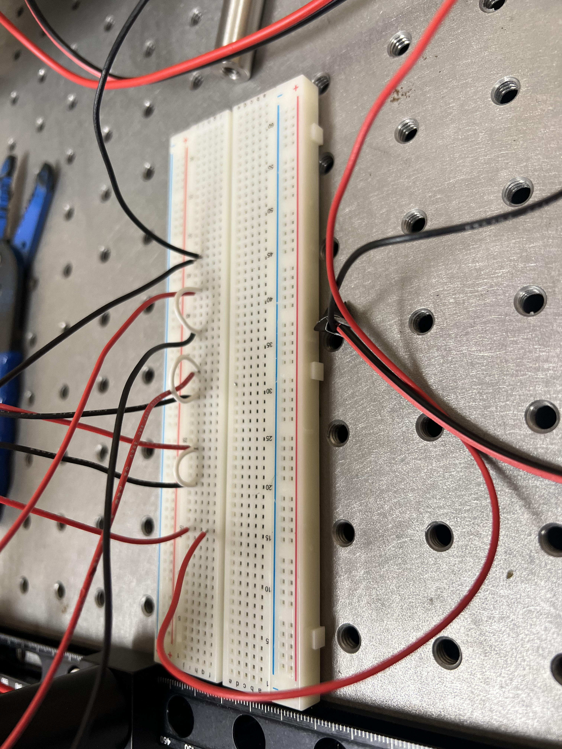
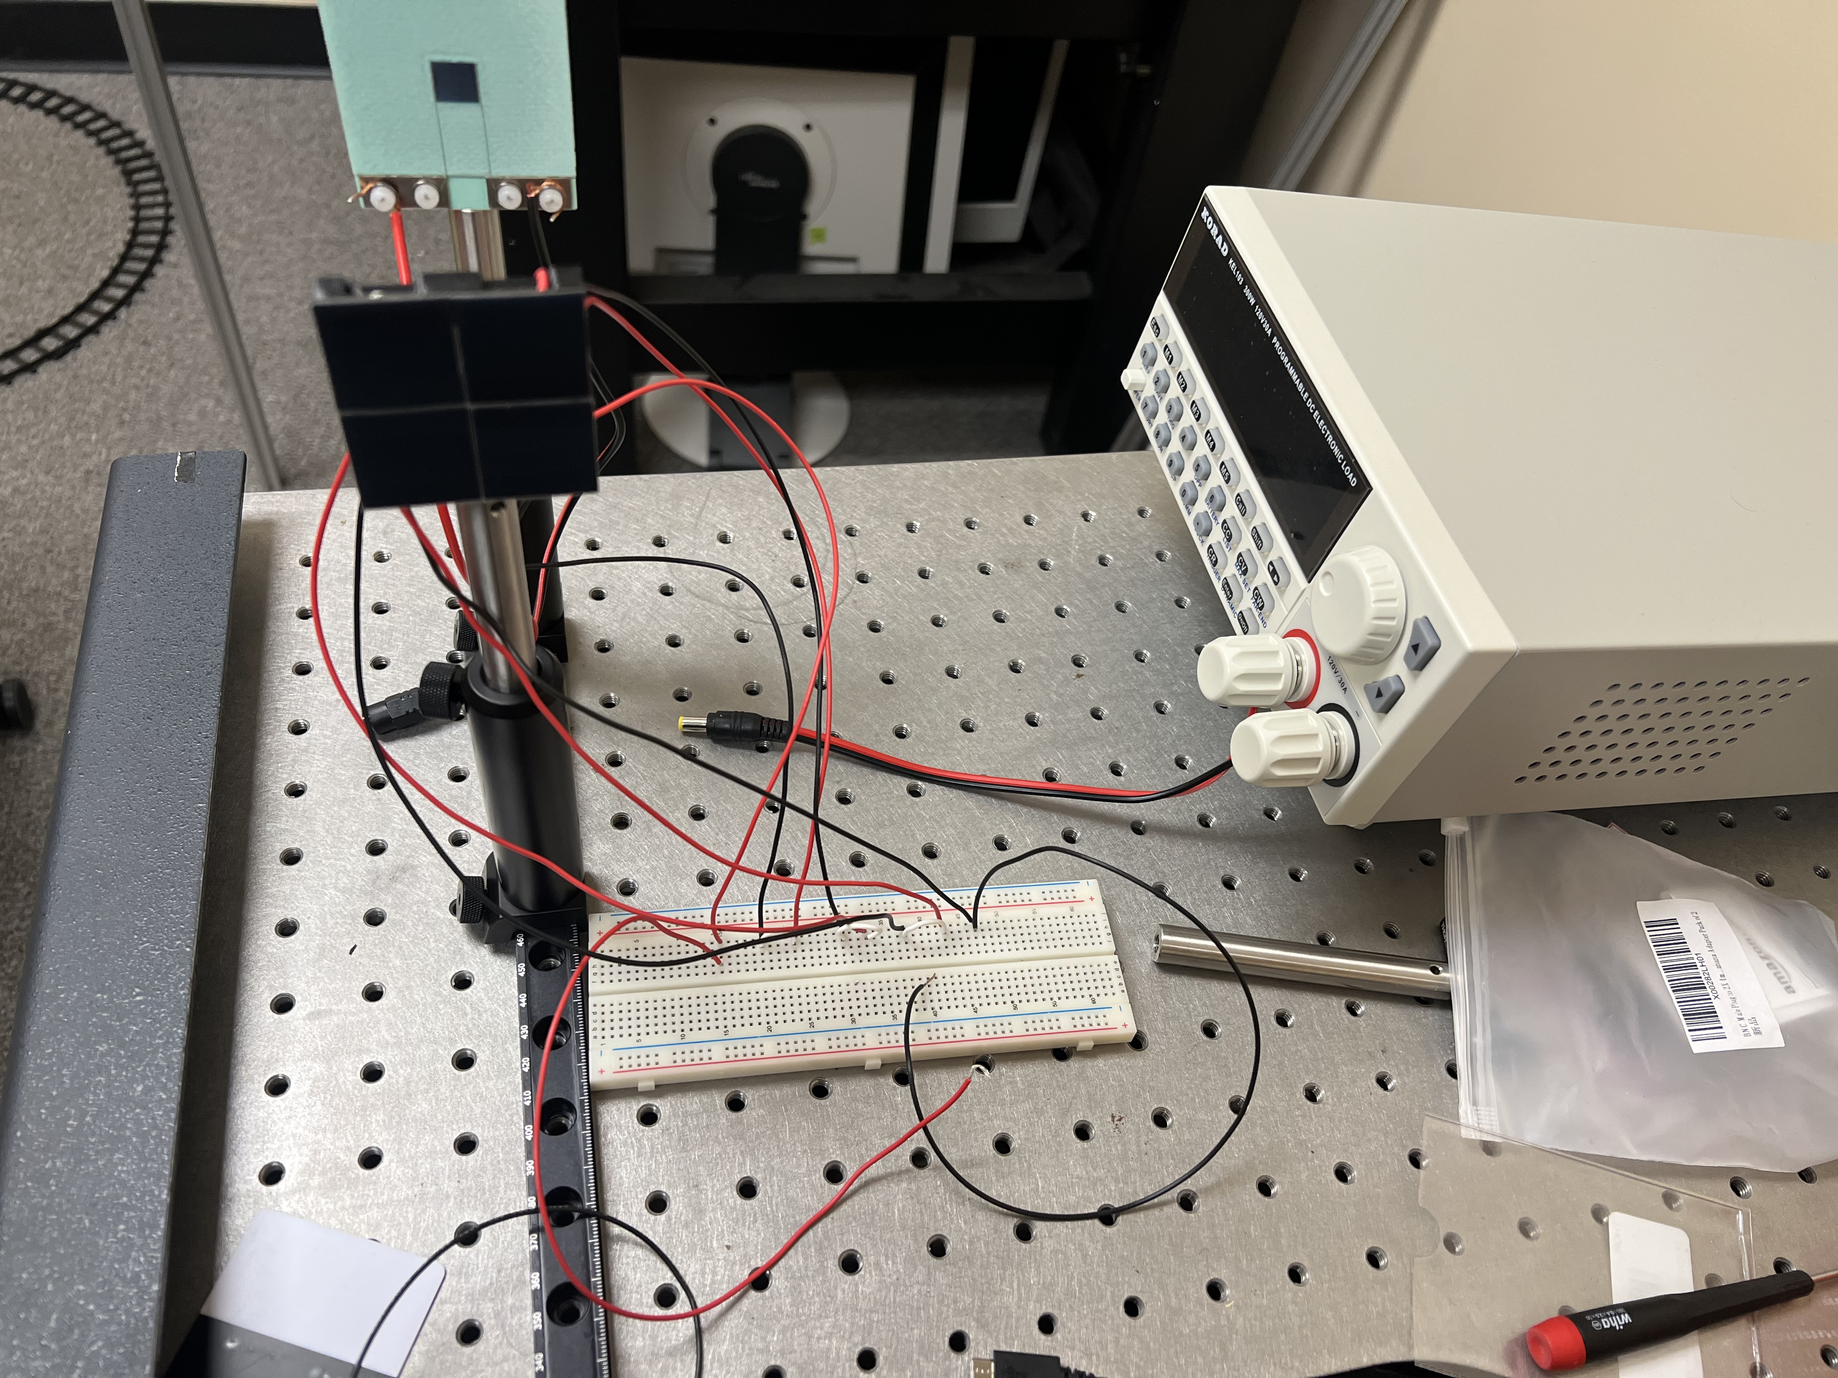
Series Arrangement,
4-PV Cells,
Form Factor 2
(Unit Testing without DC-DC Converter using the Electrical Load Instrumentation)

Slide 5
Receiver Unit Testing Measurements
Input Laser Optical Power = 10 W
V_{oc} = 9.98 V
I_{actual} = 0.007 A
Output Electrical Power = (9.98 V)(0.007 A) = 0.06986 W
I_{sc} = I_{max} = 9.8 mA at V_{out} = 0 (Set)
The system demonstrates power loss based on the expected output power = 0.421024 W.

Slide 6
Preliminary Receiver System
Conceptual Block Diagram
PC Computer
Plated Temperature Sensor
Wi-Fi Video Stream
Heat_{diss}
TEG (Thermoelectric Generator)
P_{converted}
8 V < V_{in} < 30 V
V_{out} = 5 V
ESP32 Wi-Fi Camera
Solar Cell
DC-DC Converter
Heat Sink
TEC (Thermoelectric Cooler)
Operating Temperature: 25 $°C$
Receiver Conceptual Block Diagram
Solar Cell: Si-based vertical multi-junction PV cell

Slide 7
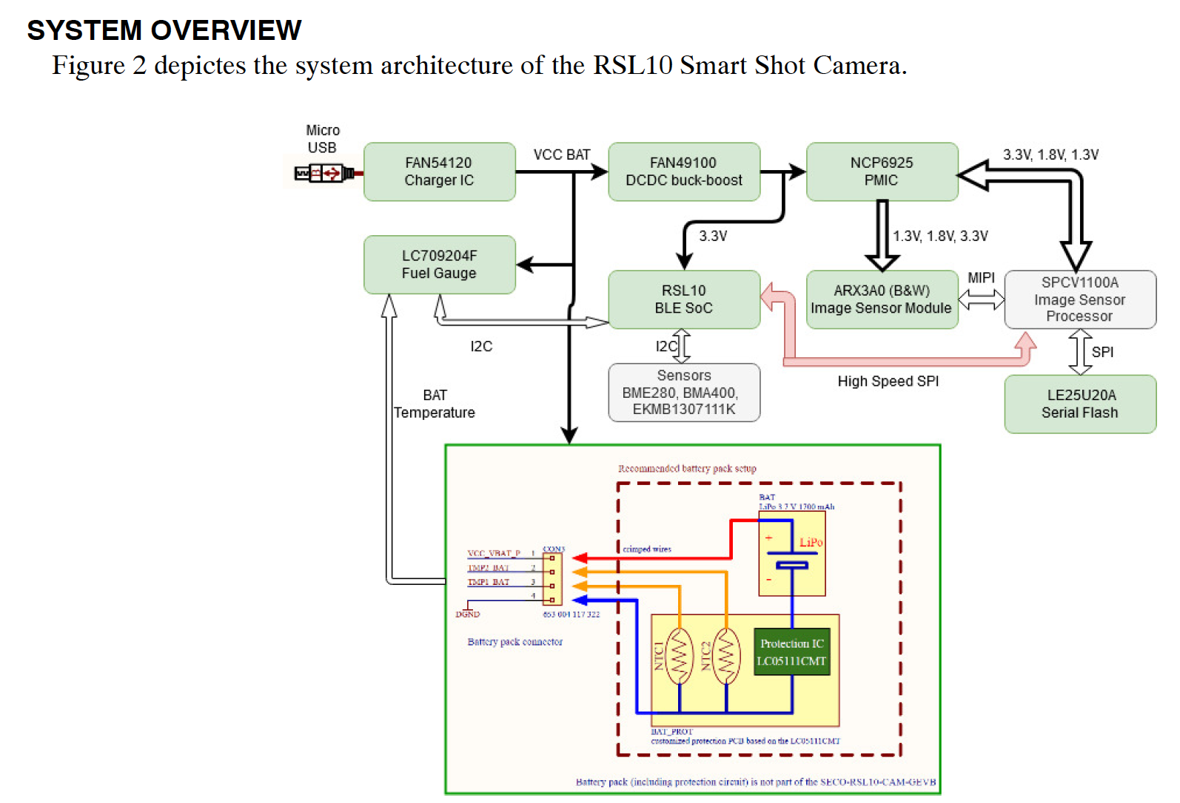
New Receiver Load: RSL20 Camera

Slide 8
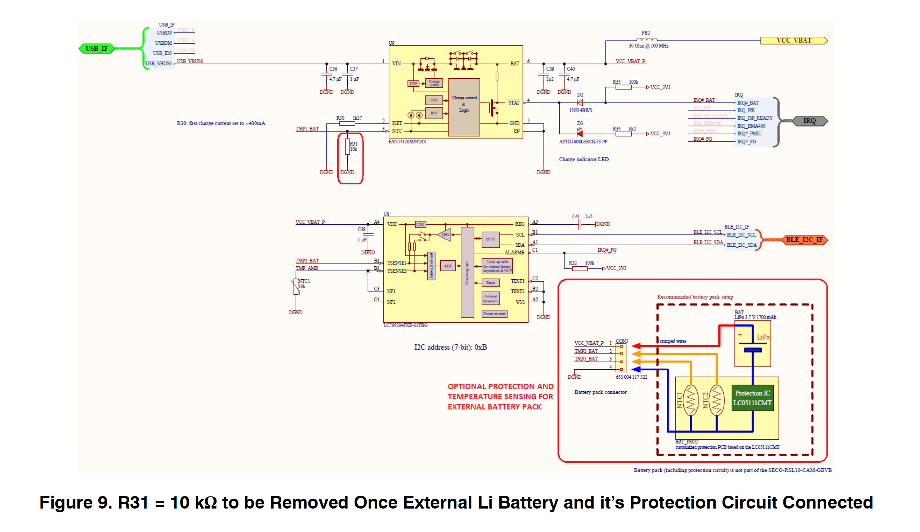
New Receiver Load: RSL20 Camera

Slide 9
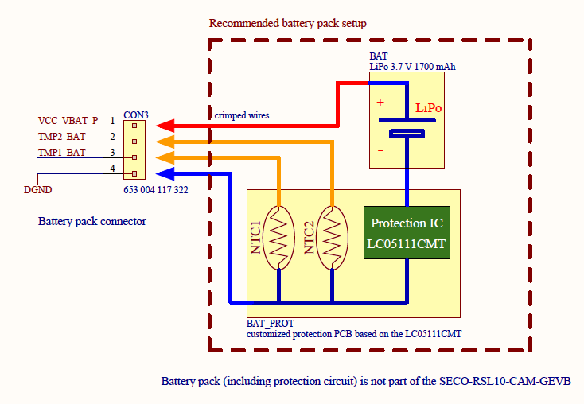
Emulating The Rechargeable Battery Unit with the PV Power Converter Circuit
CONNECTING THE RECHARGEABLE BATTERY:
• BAT type: Li or Li−Po
• BAT voltage = 3.7 V
• BAT floating voltage = 4.2 V
• Capacity = based on the use case
(recommended 1700 mAh)
The charging current of the FAN54120 is fixed on the
board to 400 mA (fast charge). The following description
and tests relate to Li−Po battery type LP435656:
3.7 V 1700 mAh fitting into the PCB design dimensions.

Slide 10
CONNECTING THE PV POWER CONVERTER “CHARGER”
TO POWER THE RSL20 CAMERA LOAD:
• Emulated BAT wattage = 3.7 V x 1700 mAh = 6.29 W
• Emulated BAT floating wattage = 4.2 V x 1700 mAh = 7.14 W
The charging current of the FAN54120 Charger IC is fixed on the
board to 400 mA (fast charge):
• Emulated BAT fast charge wattage = 3.7 V x 400 mA = 1.48 W

Slide 11
Circuit Design # | PV Cell Arrangement Type | Number of PV Cells | PV Cell Form Factor | DC-DC Converter Type | Output Voltage | Output Current | Output Power
1 | Series | 4 | 1 cm x 1 cm (10 mm x 10 mm) | Boost | 29.21 V x 4 PV cells = 116.84 V | 0.02029 A | 2.3706836 W
2 | Isolated | 1 | 1 cm x 1 cm (10 mm x 10 mm) | Boost | 29.21 V x 1 PV cell = 29.21 V | 0.02029 A | 0.5926709 W
3 | Parallel | 4 | 1 cm x 1 cm (10 mm x 10 mm) | Boost | 29.21 V | 0.02029 A x 4 PV cells = 0.08116 A | 2.3706836 W
4 | Parallel | 4 | 2.5 cm x 2.5 cm (25 mm x 25 mm) | Boost | 2.23 V | 0.0472 A at Pmpp | 0.105256 W
5 | Series | 4 | 2.5 cm x 2.5 cm (25 mm x 25 mm) | Boost | 2.23 V x 4 PV cells = 8.92 V | 0.0472 A at Pmpp | 0.421024 W
6 | Parallel | 4 | 2.5 cm x 2.5 cm (25 mm x 25 mm) | Boost | 2.23 V | 0.0472 A at Pmpp | 0.105256 W
7 | Series | 4 | 5 cm x 5 cm (50 mm x 50 mm) | Boost | 2.43 V x 4 PV cells = 9.72 V | 0.14 A | 1.3608 W
8 | Parallel | 4 | 5 cm x 5 cm (50 mm x 50 mm) | Boost | 2.23 V | 0.14 A x 4 PV cells = 0.56 A | 1.2488 W

Slide 12
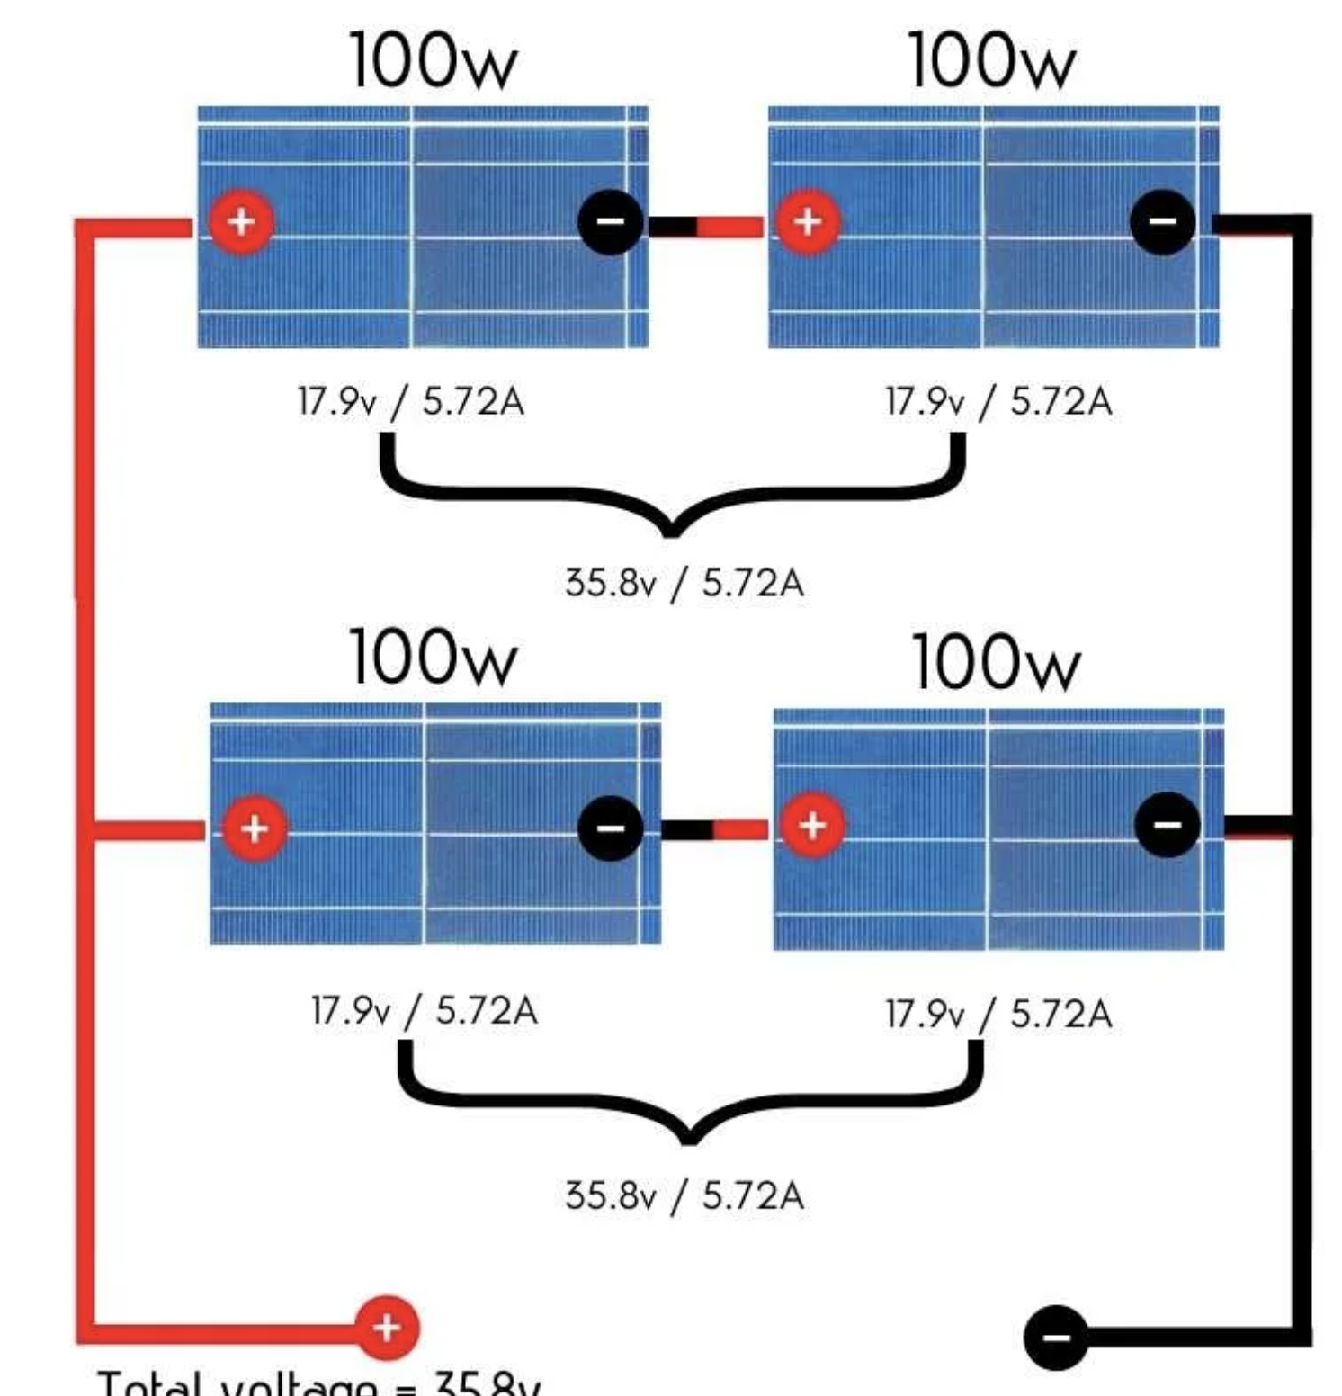
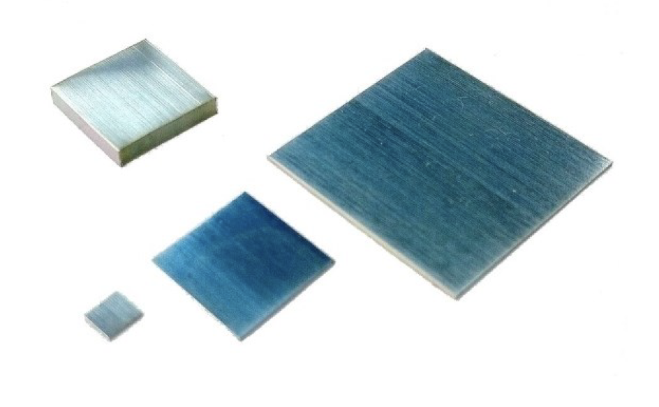
1. Design Specifications 1 cm x 1 cm MIH® VMJ PV Cell Form Factor, 4-PV, Series
PV 2
PV 1
Peripherals:
Inputs:
PV Array: 2 leads (+ and -) x 4 PV cells = 8 leads
TEG module’s 2 leads (+ and -)
TEC module’s 2 leads (+ and -)
Outputs:
ESP-32 Wi-Fi camera
Internals:
Pads for soldered PV cells
I/O Ports as Female Connectors
Voltage Requirements:
Input:
Each PV cell has a 0.02029 A maximum current output
Each PV cell has a 29.21 V maximum voltage output
Each PV cell has a 0.59267 W maximum power output
Total max V_{out} = 29.21 V x 4 PV cells; Voltage output = 116.84 V for a series connection
Total max current = 0.02029 A for a series connection
Output: 5 V at 180 mA *or .18 A = 0.9 W
Miscellaneous:
Heat Sink
PV 3
PV 4
*Required Separately: Buck DC-DC Converter circuit: 116.84 V to 5 V

Slide 13
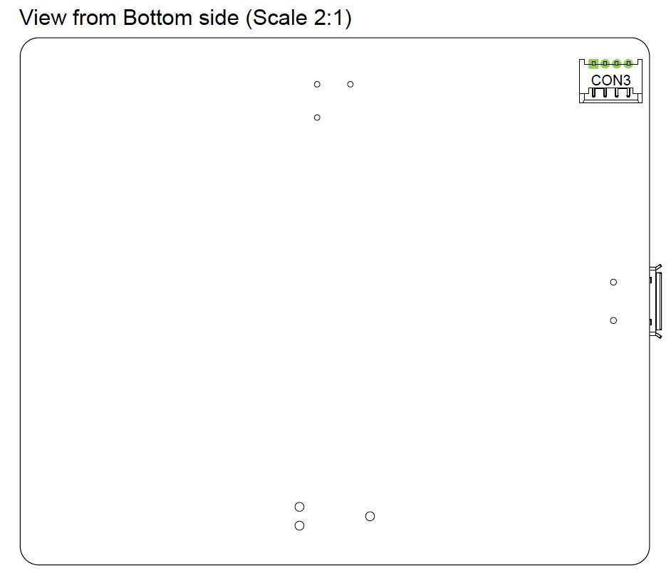
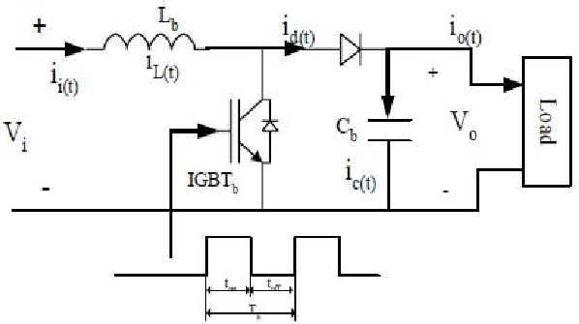
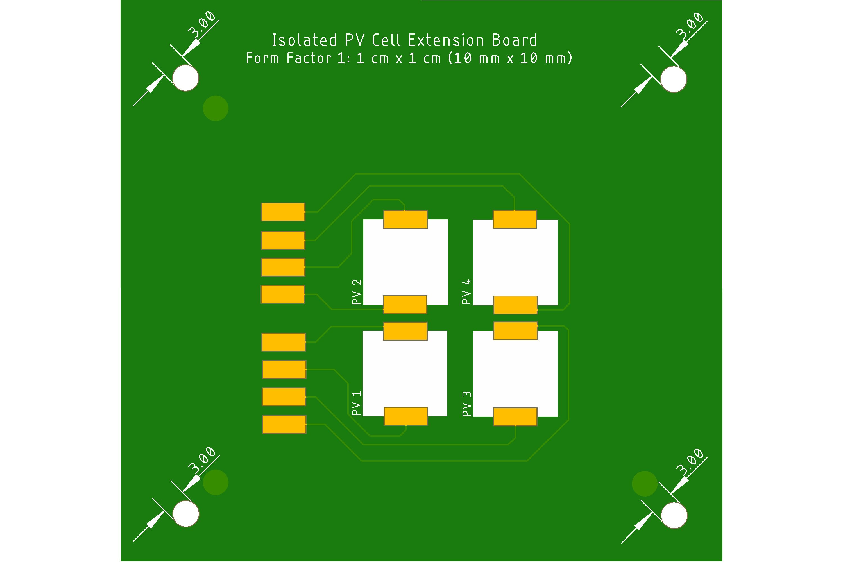
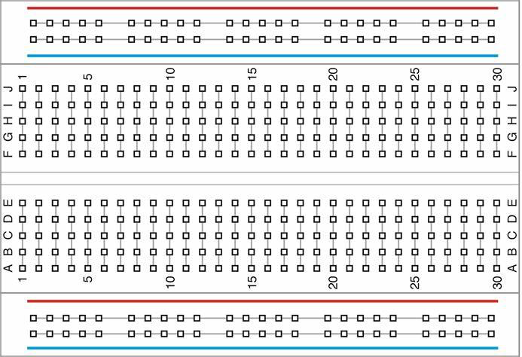
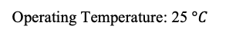
Updated Receiver System
Conceptual Block Diagram
RSL20 Camera
Boost DC-DC Converter
-
+
+
+
PV 2
PV 3
+
-
-
-
+
+
+
-
PV 1
PV 4
-
-
-
+
Heat Sink
Operating Temperature: 25 $°C$

Slide 14
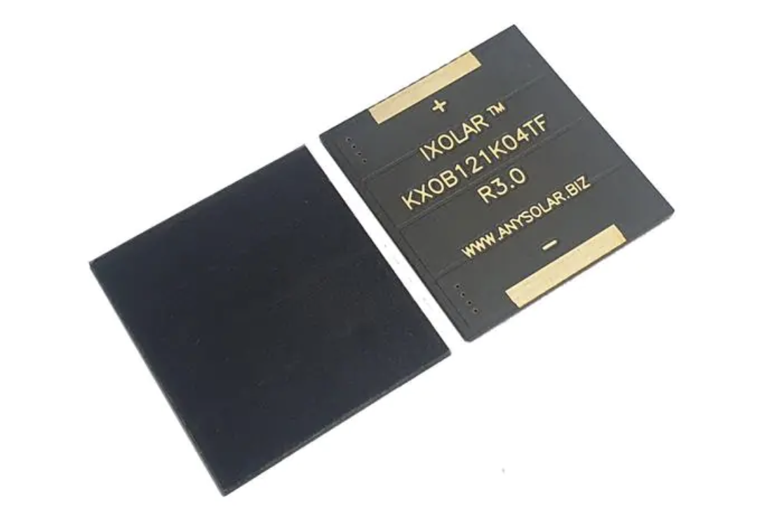
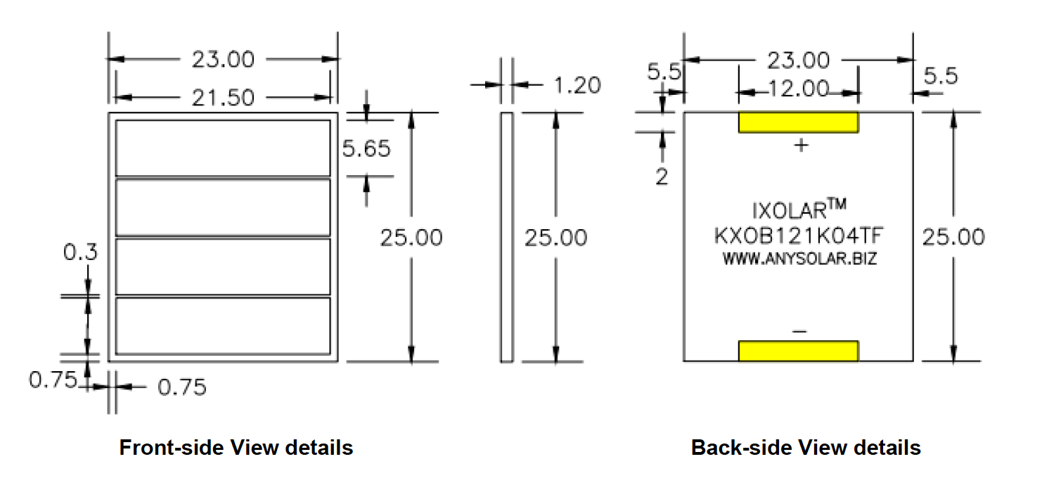
5. Design Specifications, 2.5 cm x 2.5 cm PV Cell Form Factor, 4-PV, Series
PV 2
PV 1
Peripherals:
Inputs:
PV Array: 2 leads (+ and -) leads
TEG module’s 2 leads (+ and -)
TEC module’s 2 leads (+ and -)
Outputs:
ESP-32 Wi-Fi camera
Internals:
Pads for soldered PV cells
PWM Control DSP, MCU, or FPGA for Switch Control
Buck DC-DC Converter circuit with Low-Pass Filter: 8.92 V to 5 V
- R, L, C, MOSFET Switch (Voltage-Controlled)
I/O Ports as Female Connectors
Voltage Requirements:
Input: 8 - 30 V:
Each PV cell has a 0.1053 W maximum power output
Each PV cell has a 2.23 V voltage output at Pmpp
Total V_{out} = 2.23 V x 4 PV cells; Voltage output = 8.92 V for a series connection
Total current = 0.0472 A current output at Pmpp for a series connection
Output: 5 V at 180 mA or 0.18 A = 0.9 W
Miscellaneous:
Heat Sink
PV 3
PV 4

Slide 15
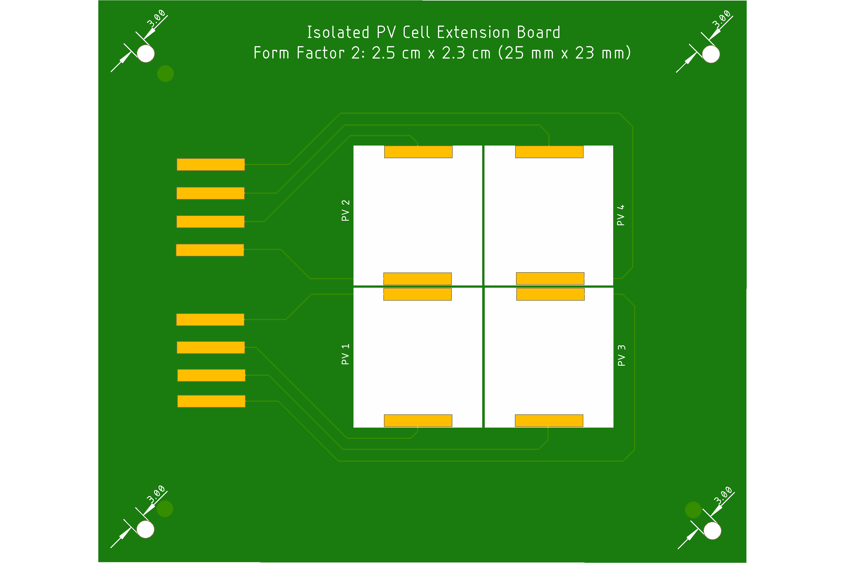
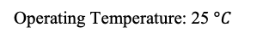
Updated Receiver System
Conceptual Block Diagram
RSL20 Camera
Boost DC-DC Converter
-
+
+
+
PV 2
PV 3
+
-
-
-
+
+
+
-
PV 1
PV 4
-
+
-
-
Heat Sink
Operating Temperature: 25 $°C$

Slide 16
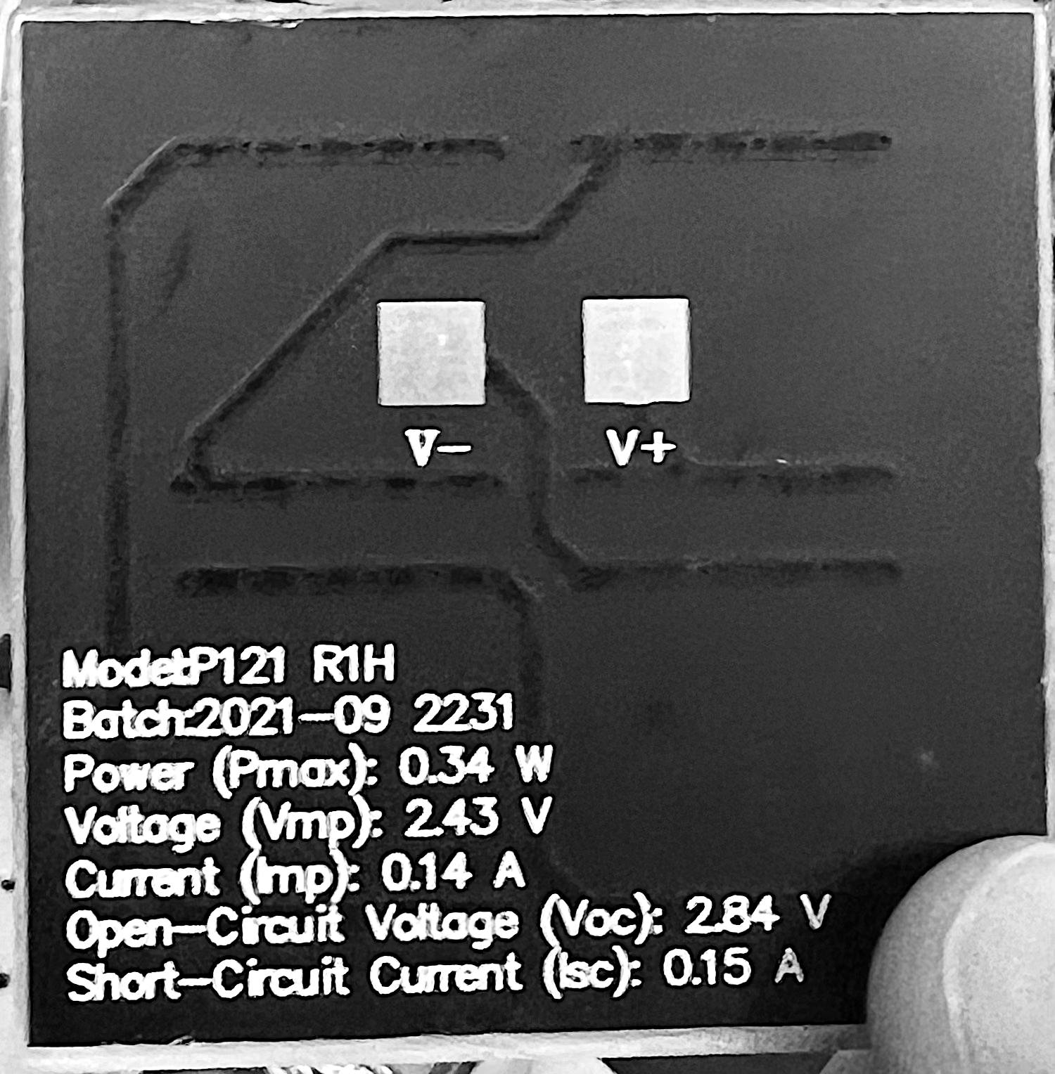
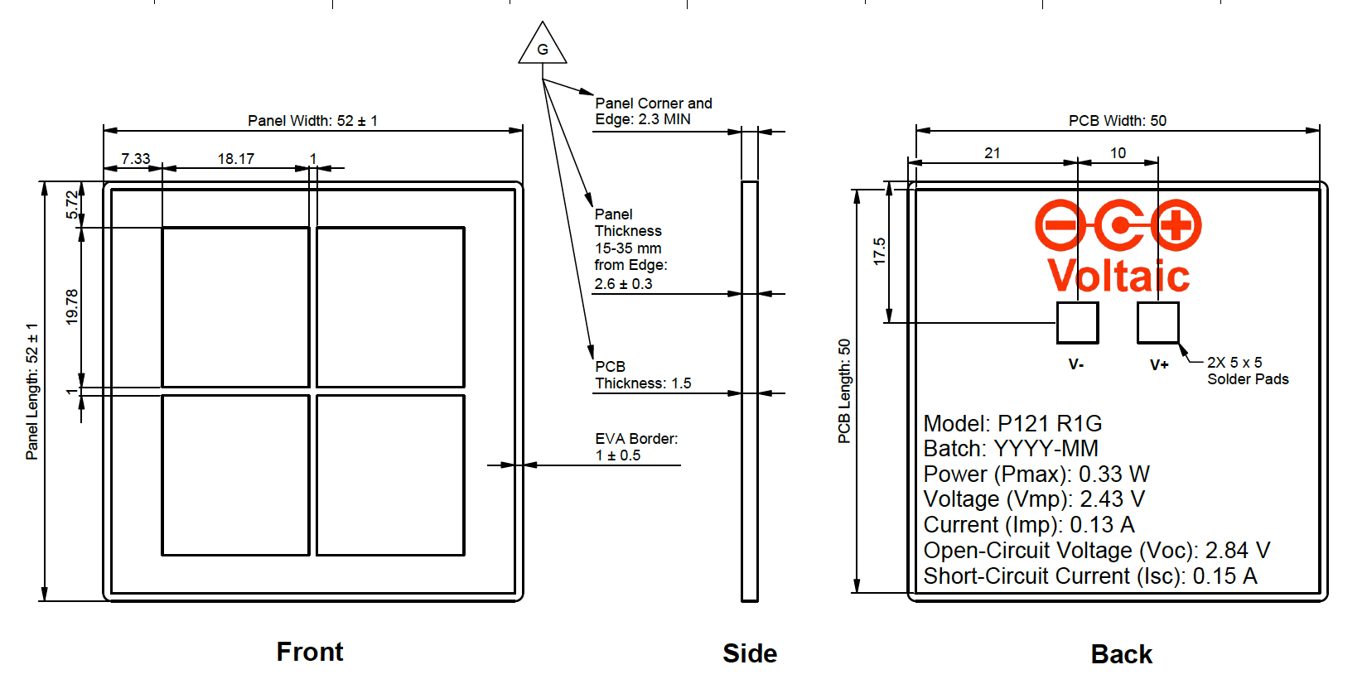
7. Design Specifications, 5 cm x 5 cm PV Cell Form Factor, 4-PV, Series
PV 2
PV 1
Peripherals:
Inputs:
PV Array: 2 leads (+ and -) leads
TEG module’s 2 leads (+ and -)
TEC
Outputs:
ESP-32 Wi-Fi camera
Internals:
Pads for soldered PV cells
PWM Control DSP, MCU, or FPGA for Switch Control
Buck DC-DC Converter circuit with Low-Pass Filter: 9.72 V to 5 V
- R, L, C, MOSFET Switch (Voltage-Controlled)
I/O Ports as Female Connectors
Voltage Requirements:
Input: 8 - 30 V:
Each PV cell has a 0.34 W power output
Each PV cell has a 2.43 V voltage output
Total V_{out} = 2.43 V x 4 PV cells; Voltage output = 9.72 V for a series connection
Total current = 0.14 A for a series connection
Output: 5 V at 180 mA or 0.18 A = 0.9 W
Miscellaneous:
Heat Sink
PV 3
PV 4

Slide 17
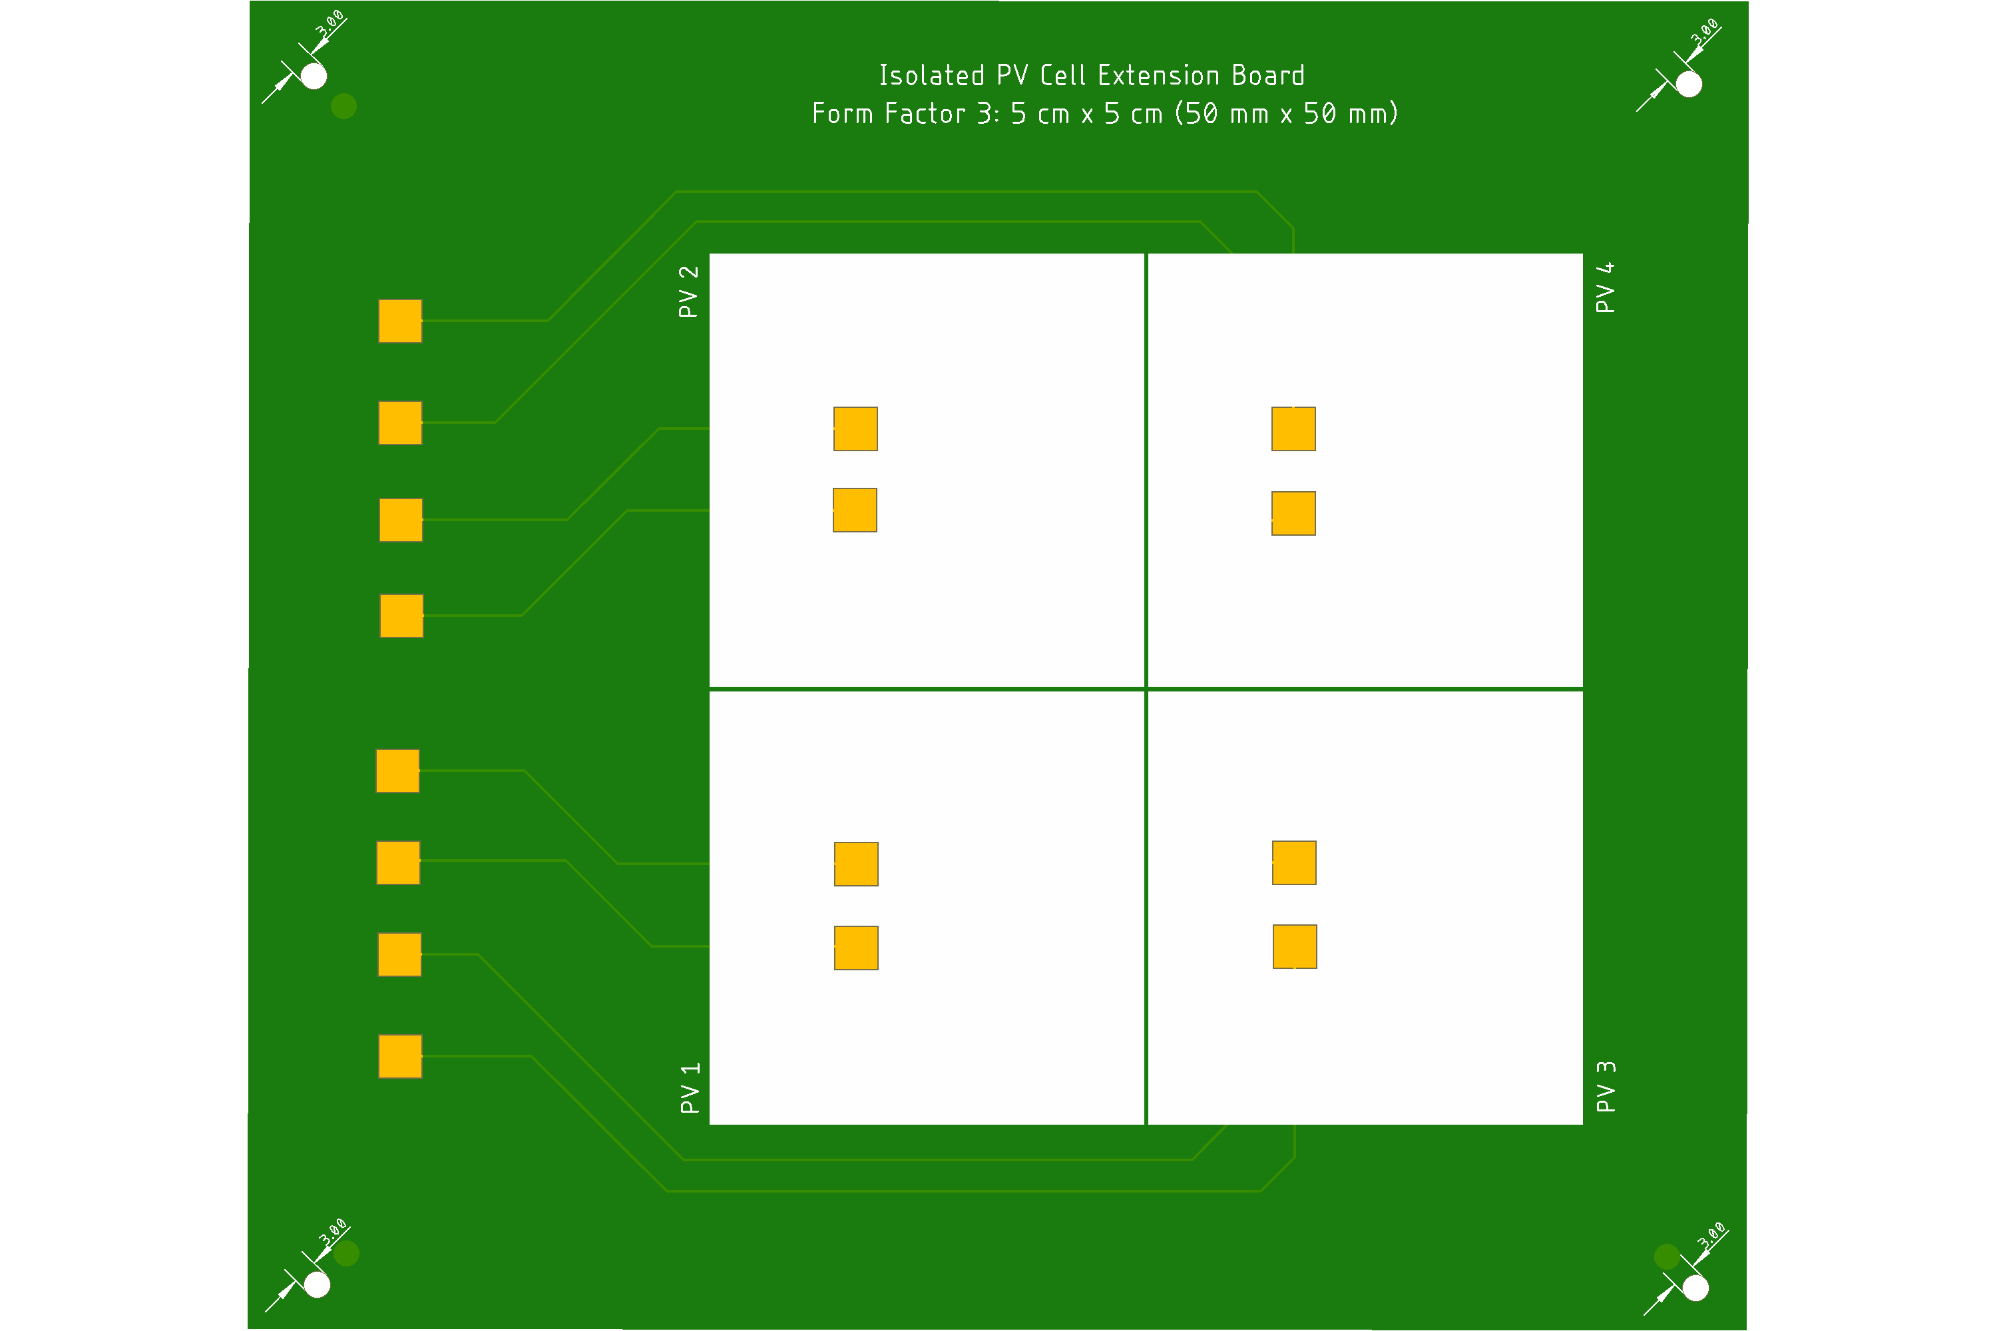
Updated Receiver System
Conceptual Block Diagram
RSL20 Camera
Boost DC-DC Converter
-
+
+
PV 2
+
PV 3
+
-
-
-
+
-
+
PV 1
+
PV 4
-
-
-
+
Heat Sink
Operating Temperature: 25 $°C$

